Slide 1


INNOVATION SINCE - 2014

Slide 2

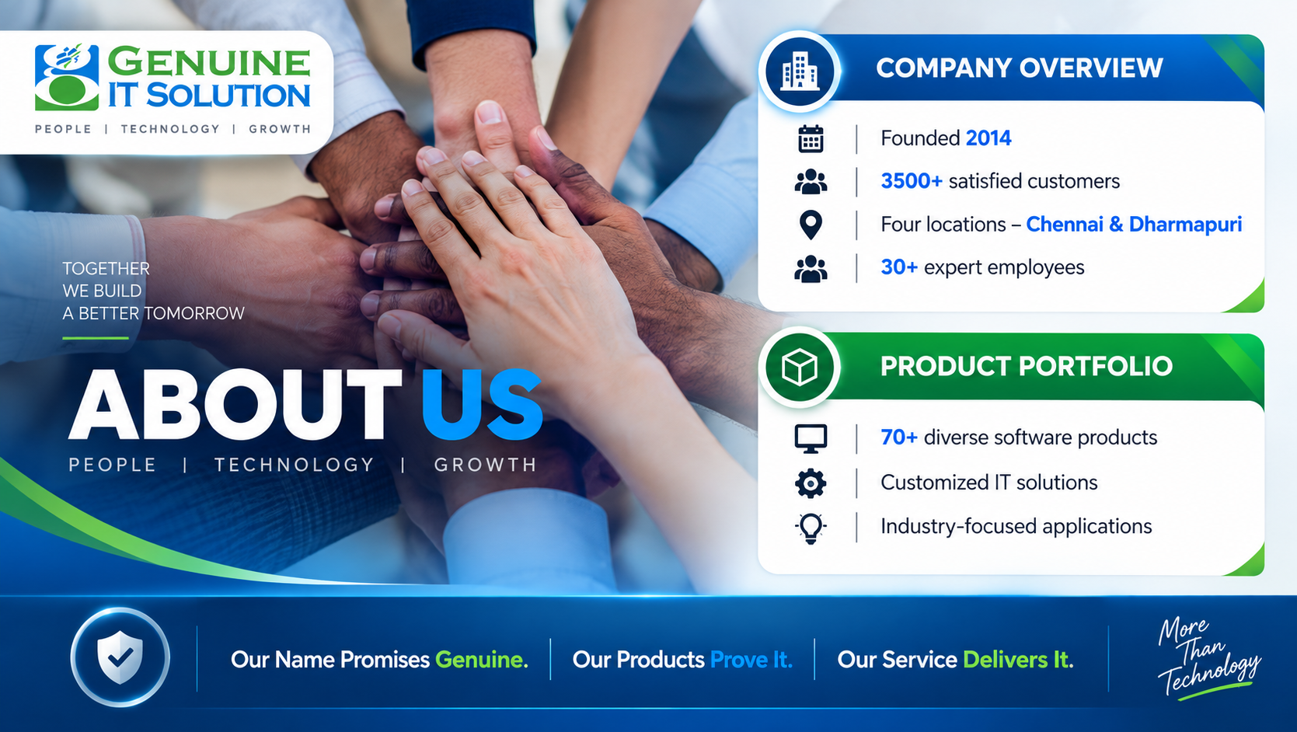

COMPANY OVERVIEW -
Founded 2014
3500+ satisfied customers
Four locations – Chennai & Dharmapuri.
30+ expert employees
PRODUCT PORTFOLIO -
70+ diverse software products
Customized IT solutions
Industry-focused applications
Our Name Promises Genuine. Our Products Prove It. Our Service Delivers It.

Slide 3
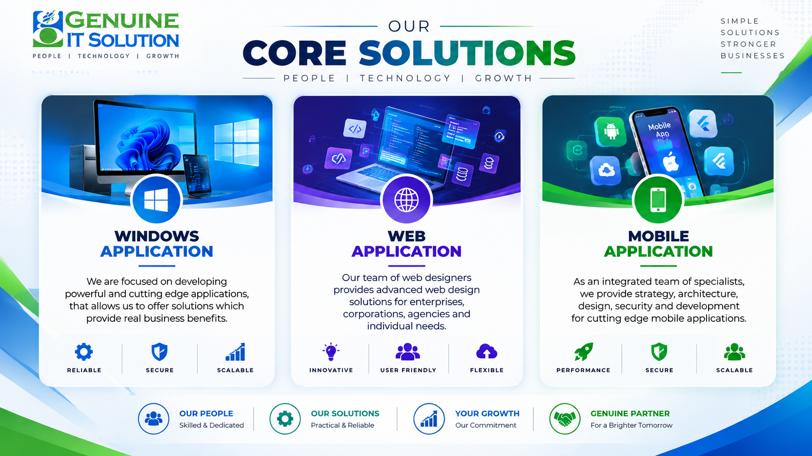



WEB APPLICATION
.
MOBILE APPLICATION
.
WINDOWS APPLICATION
.
.
Our team of web designers provides advanced web design solutions for enterprises, corporations, agencies and individual needs.
.
As an integrated team of specialists, we provide strategy, architecture, design, security and development for cutting edge mobile applications.
We are focused on developing powerful and cutting edge applications, that allows us to offer solution which provide real business benefits.

Slide 4



IT SOLUTIONS FOR ALL INDUSTRIES
Get ultimate control over your business process and maximize your efficiency and output by using genuine ERP, Manage all aspects of your business with Genuine ERP, from financial management to inventory control and manufacturing operations.

Slide 5


THE WAY WE WORK
Curiosity and innovation
Listening is a great way.
We value Planning and discipline.
We do things the ethical way
We always deliver on time
We always get back to people.

Slide 6


FLEXIBLE SOLUTION FOR YOUR BUSINESS NEEDS
INDUSTRY SOLUTIONS :
ERP Application
Barcode Tracking Applications
Stock / Inventory Software
HR Payroll Software
Asset Tracking Software
Visitor Mangement Software
CRM Software
Warehouse Software
RETAIL SOLUTIONS :
  Retail POS Billing System
  Textile POS Billing System
  Jewellery POS Billing System
  Medical Billing Software
  Lodge Mangement Software
  Daily Chit Collection Software
  Lab Management Software
  Parking Software

Slide 7





THANK YOU
- Genuine IT Solution
www.genuineitsolution.in
Mail : info@genuineitsolution.in
+91 7845022332, +91 9940860219

